Slide 1
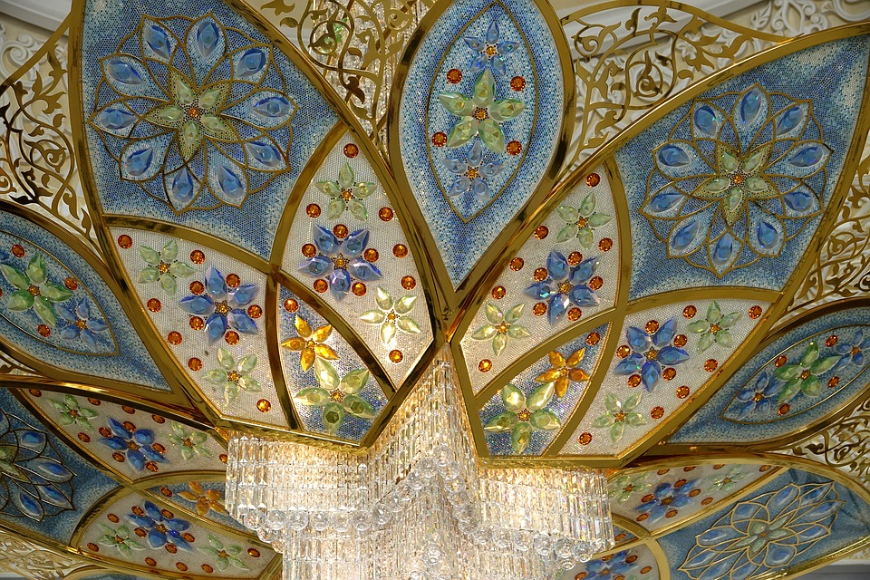
DESIGNING THE WORLD AROUND ME:
MATHEMATICS AND CULTURAL INSPIRATION IN DESIGN
Notes:
Image: Mosque Abu Dhabi Uae Islam: https://www.maxpixel.net/Mosque-Abu-Dhabi-Uae-Islam-Large-Mosque-2823720 (CC0 Public Domain)

Slide 2
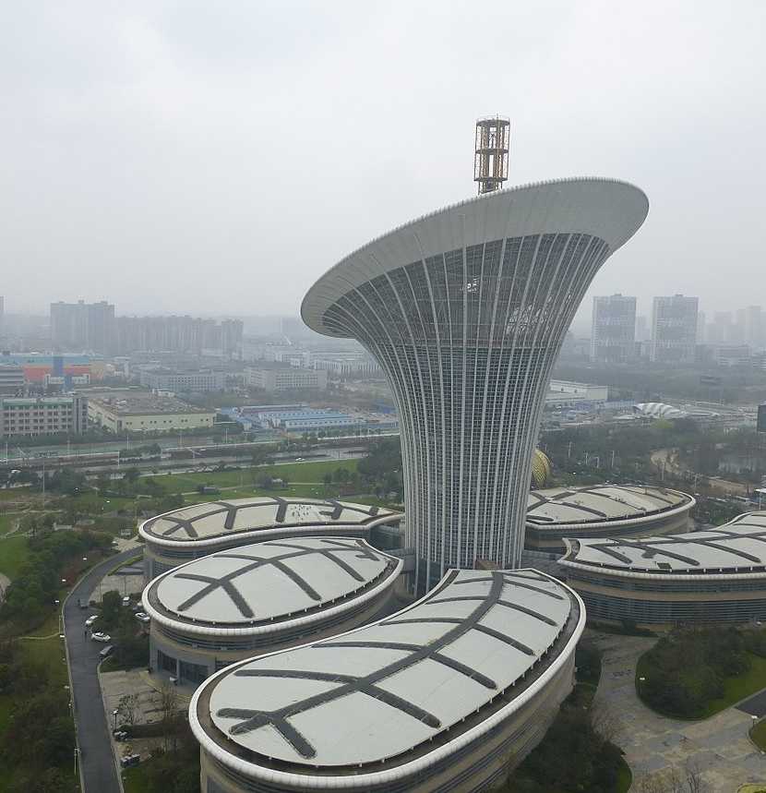
Imagine you are a designer of the future ...
... you need to combine a feeling for what is beautiful with an understanding of mathematics ...
... watch Ars Qubica movie ...
Image credits: User:Vmenkov [CC BY-SA 3.0 (https://creativecommons.org/licenses/by-sa/3.0)] https://commons.wikimedia.org/wiki/File:Wuhan_-_Future_City_-_Area_G_-_P1530366.JPG
Notes:
http://www.etereaestudios.com/docs_html/arsqubica_htm/index.htm

Slide 3

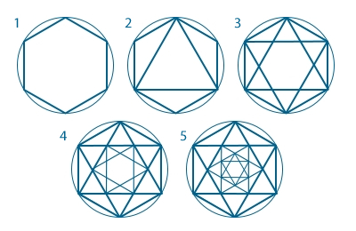
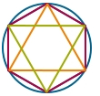
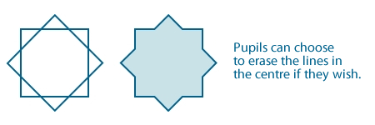
Start with ... a circle and some regular polygons
Combine them:
Images credits: School of Islamic Geometric Design (http://www.sigd.org/resources/)
Notes:
More resources and step-by-step instructions on design: School of Islamic Geometric Design (http://www.sigd.org/resources/)

Slide 4
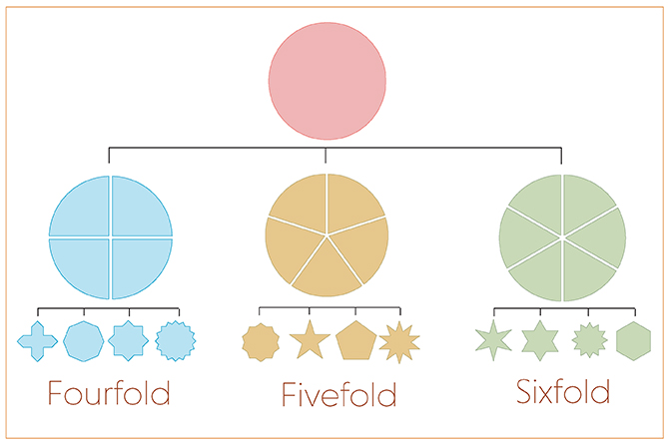
Islamic Geometric Family Tree
Images credits: School of Islamic Geometric Design (http://www.sigd.org/resources/)
Notes:
More on http://www.sigd.org/resources/basic-design-principles/
„About 90% of all patterns and compositions you will ever see, can be categorised as either fourfold, fivefold or sixfold.”

Slide 5
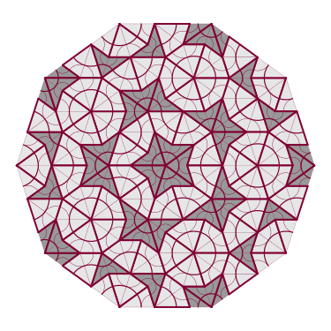
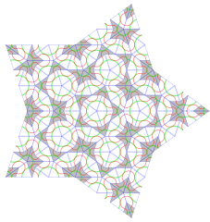
Tiling with five fold symmetry
Image 1: https://commons.wikimedia.org/wiki/File:Penrose_sun_3.svg
Image2: https://commons.wikimedia.org/wiki/File:SSS_Penrose_tiling,_4iter,_star.svg
Notes:
Image 1: https://commons.wikimedia.org/wiki/File:Penrose_sun_3.svg
Other: https://commons.wikimedia.org/wiki/File:Penrose7.gif (Public Domain)
Image 2: https://commons.wikimedia.org/wiki/File:SSS_Penrose_tiling,_4iter,_star.svg

Slide 6
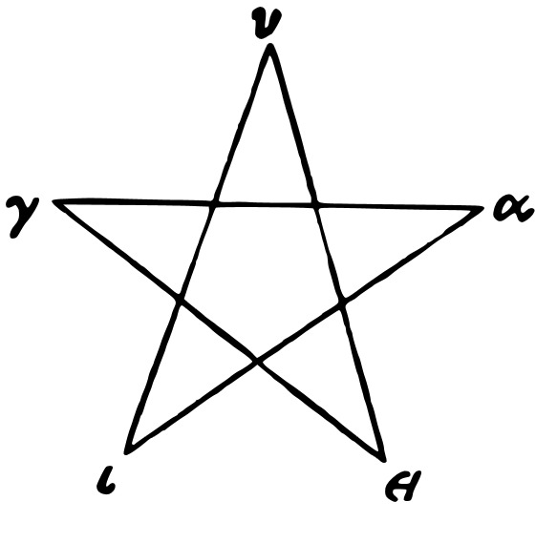
The pentagram
The pentagram has been used by many different peoples as a symbol of significance. It is said to have been used as a sign of recognition by the Pythagoreans.
A Pythagorean "Hugieia Pentagram"
Image: https://commons.wikimedia.org/wiki/File:Hugieia-pentagram.svg
Notes:
https://commons.wikimedia.org/wiki/File:Hugieia-pentagram.svg
Other info: https://en.wikipedia.org/wiki/Pentagram

Slide 7
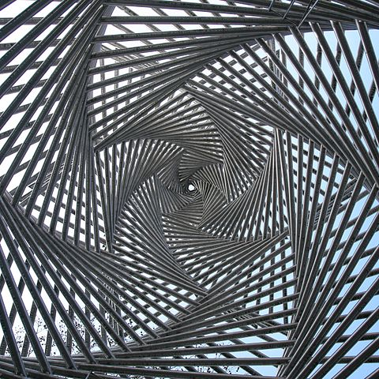
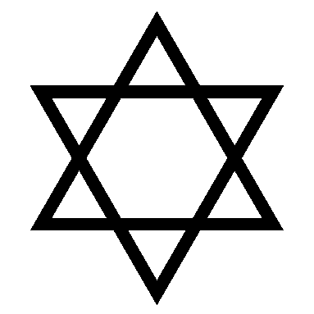
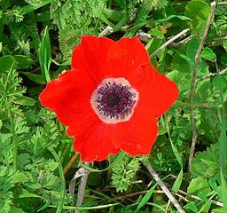
Symbols (1/5)
Jewish Religious Symbol-
the Star of David
Anemone coronaria with 6 petals creating Star of David
Inside the memorial at the site of the former Synagogue in Göttingen, Germany
Image: https://commons.wikimedia.org/wiki/File:Starofdavid.png
Image: https://commons.wikimedia.org/wiki/File:Calanit006.jpg
Image: https://commons.wikimedia.org/wiki/File:Goe_Platz_der_Synagoge_Detail_2.jpg
Notes:
Image 1: https://commons.wikimedia.org/wiki/File:Starofdavid.png
Image 2: https://commons.wikimedia.org/wiki/File:Calanit006.jpg
Image 3: https://commons.wikimedia.org/wiki/File:Goe_Platz_der_Synagoge_Detail_2.jpg
Other image: https://commons.wikimedia.org/wiki/File:Leningrad_Codex_Carpet_page_e.jpg
More on religious symbols: https://www.ancient-symbols.com/religious_symbols.html

Slide 8
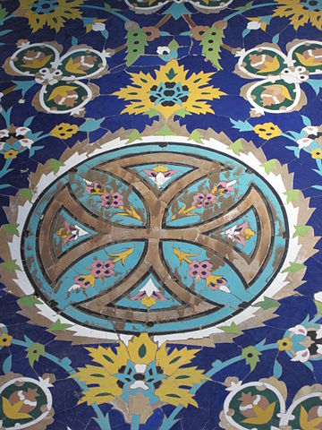

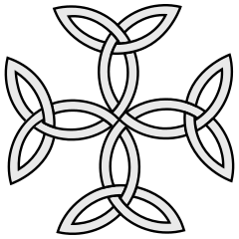
Symbols (2/5)
Christianity Cross
Carolingian Cross - represents unity, balance and the eternity of God.
Christian hospital, tiled cross symbol
Image 3: https://commons.wikimedia.org/wiki/File:Christian_hospital,_tiled_cross_symbol,from_Mr._Isa_Bahadori_works_in_Isfahan..JPG
Image 1: https://commons.wikimedia.org/wiki/File:Christian_cross.svg
Image 2: https://commons.wikimedia.org/wiki/File:Coa_Illustration_Cross_Carolingian.svg
Notes:
Image 1: Boris23 (talk · contribs) [Public domain] https://commons.wikimedia.org/wiki/File:Christian_cross.svg
Image 2: https://commons.wikimedia.org/wiki/File:Coa_Illustration_Cross_Carolingian.svg
Image 3: https://commons.wikimedia.org/wiki/File:Christian_hospital,_tiled_cross_symbol,from_Mr._Isa_Bahadori_works_in_Isfahan..JPG
More on religious symbols: https://www.ancient-symbols.com/religious_symbols.html

Slide 9

Symbols (3/5)
Islamic Crescent moon
Mosque Abu Dhabi UAE Islam
Image 1: https://svgsilh.com/image/1301942.html
Image 2: https://www.maxpixel.net/Mosque-Abu-Dhabi-Uae-Islam-Large-Mosque-2823720
Notes:
Img1: Crescent Moon: https://svgsilh.com/image/1301942.html (Public Domain)
Img2: Mosque Abu Dhabi Uae Islam: https://www.maxpixel.net/Mosque-Abu-Dhabi-Uae-Islam-Large-Mosque-2823720 (CC0 Public Domain)
More on religious symbols: https://www.ancient-symbols.com/religious_symbols.html
Other examples of decorations:
https://www.dreamstime.com/royalty-free-stock-photography-islam-pattern-texture-background-image17194657
https://www.maxpixel.net/Travel-Abu-Dhabi-Mosque-White-Orient-Architecture-615415

Slide 10
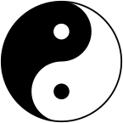

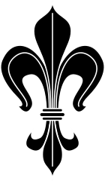
Symbols (4/5)
Yin-Yang
The yin, the dark swirl, is associated with shadows, femininity, and the trough of a wave; the yang, the light swirl, represents brightness, passion and growth.
Dharmachakra (Dharma wheel) – used in Budhism
– a symbol of the ideal kingdom
”Truth Alone Triumphs”
Fleur-de-lis (flower-de-luce/ lily)
The three leaves represent the medieval social classes:
those who worked,
those who fought
those who prayed.
It is especially used by the knights in Europe.
Image 1: By Kenny Shen - Own work, Public Domain, https://commons.wikimedia.org/w/index.php?curid=2612981
Image 2: https://commons.wikimedia.org/wiki/File:Wheel_of_Dharma.svg
Image 3: https://commons.wikimedia.org/wiki/File:Lilie_stilisiert_2.svg
Notes:
Image 1: By Kenny Shen - Own work, Public Domain, https://commons.wikimedia.org/w/index.php?curid=2612981
Image 2: https://commons.wikimedia.org/wiki/File:Wheel_of_Dharma.svg
Image 3: https://commons.wikimedia.org/wiki/File:Lilie_stilisiert_2.svg
More on religious symbols: https://www.ancient-symbols.com/religious_symbols.html

Slide 11
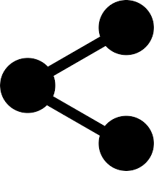
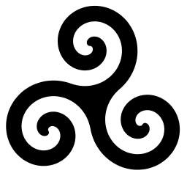
Symbols (5/5)
Share symbol - used on the internet to identify shareable content. It aims to convey the act of sharing visually by representing one hand passing an object to another hand, while also representing an eye looking on.
Triskelion - an ancient Celtic symbol found in many places including Malta (4400-3600 BC) and Ireland (around 3200 BC). It represents many things of a triple nature: for example the movement of life which is formed of past, present and future.
Image 1: https://svgsilh.com/image/880816.html
Image 2: https://commons.wikimedia.org/wiki/File:Triskele-Symbol-spiral-five-thirds-turns.svg
Notes:
Image 1: https://svgsilh.com/image/880816.html
Image 2: https://commons.wikimedia.org/wiki/File:Triskele-Symbol-spiral-five-thirds-turns.svg

Slide 12
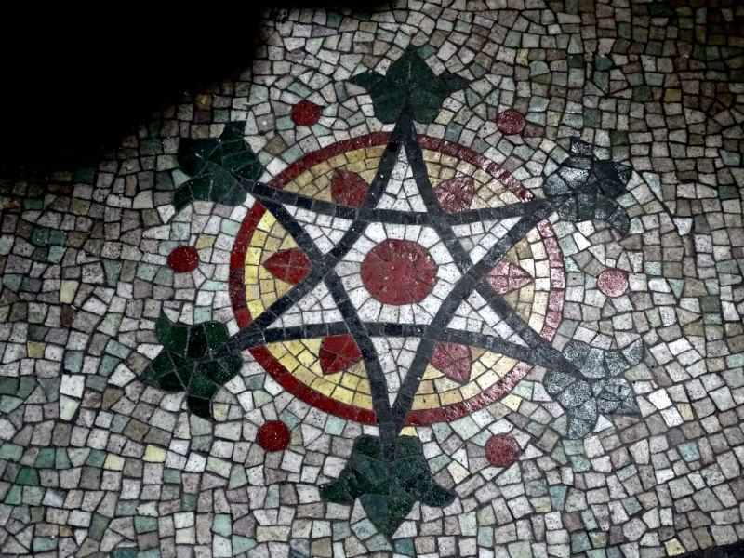
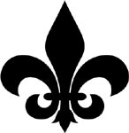
Combinations of symbols
Star of David (or Shield of David)
The two interlocking triangles could represent the reciprocal relationship between human being and God.
Tiles in St Peter's Church, Wallingford
Fleur-de-lis – three social classes
Image 1: https://commons.wikimedia.org/wiki/File:Starofdavid.png
Image 2: https://commons.wikimedia.org/wiki/File:Lilie_stilisiert_2.svg
Image 3: https://medievalmosaic.com/wp-content/uploads/2017/11/Dsc08386-1.jpg
Notes:
Image 1: https://commons.wikimedia.org/wiki/File:Starofdavid.png
Image 2: https://commons.wikimedia.org/wiki/File:Lilie_stilisiert_2.svg
Image 3: St Peter's Church, Wallingford/ Wallingford Castle - https://medievalmosaic.com/wp-content/uploads/2017/11/Dsc08386-1.jpg
More on religious symbols: https://www.ancient-symbols.com/religious_symbols.html
the three leaves represent the medieval social classes: those who worked, those who fought and those who prayed.

Slide 13
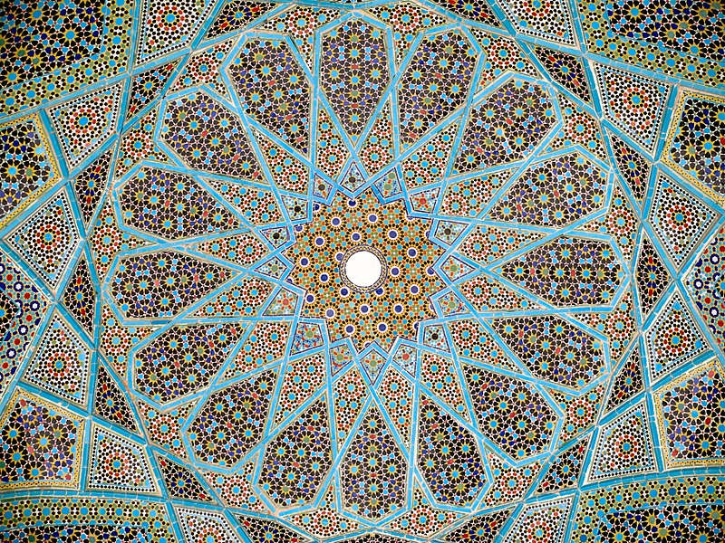
Medieval Islamic tiling reveals
mathematical savvy
See the article by Jeff Hecht on: NewScientist.com
https://www.newscientist.com/article/dn11235-medieval-islamic-tiling-reveals-mathematical-savvy/
Notes:
More on https://www.newscientist.com/article/dn11235-medieval-islamic-tiling-reveals-mathematical-savvy/

Slide 14
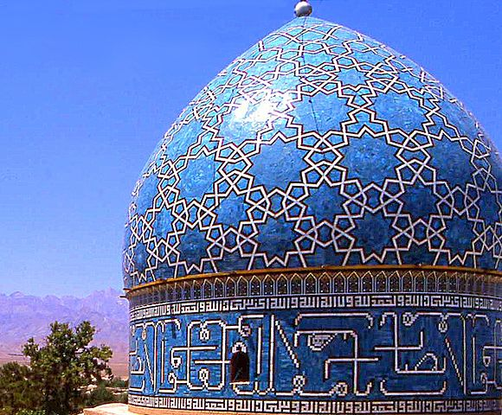
Girih designs are assembled from five regularly shaped tiles, including:
a bowtie shape,
a rhombus,
a pentagon,
an elongated hexagon,
and a decagon.
Can you spot any of these in this pattern?
Detail of dome of the
Shrine of Shah Nematollah Vali
Image source: https://commons.wikimedia.org/wiki/File:Shah_Nematollah_Vali_Shrine_13_detail.jpg Author: anaareh saaveh
Notes:
Image: https://commons.wikimedia.org/wiki/File:Shah_Nematollah_Vali_Shrine_13_detail.jpg

Slide 15
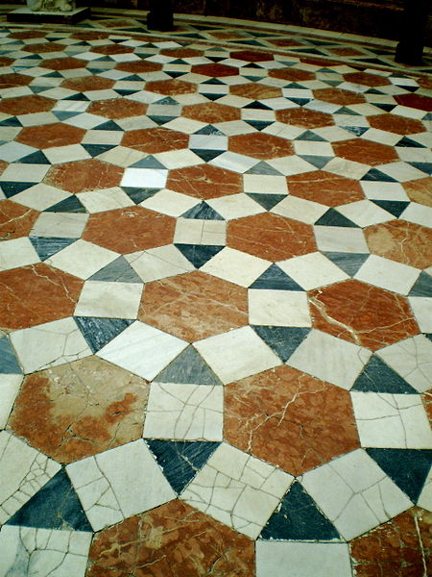
Look for tiling patterns in the environment.
Take photographs to share and discuss the mathematical properties of the tilings you have found.
Tile floor from Museo Arqueológico de Sevilla, Spain.
Semi-regular Tessellation.
Image source: https://commons.wikimedia.org/wiki/File:Semi-regular-floor-3464.JPG Author: AnnekeBart
Notes:
Tile floor from Museo Arqueológico de Sevilla, Spain. Semi-regular Tessellation. (https://commons.wikimedia.org/wiki/File:Semi-regular-floor-3464.JPG)

Slide 16
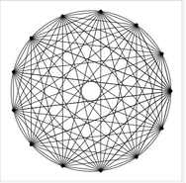
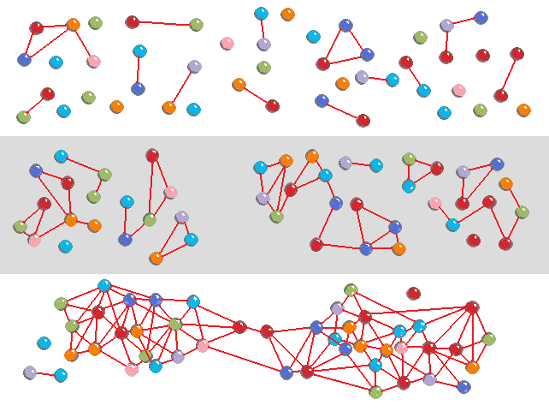
These two images could represent a social world.
https://demonstrations.wolfram.com/TheMysticRose/ https://en.wikipedia.org/wiki/File:Network_self-organization_stages.png Takemori39
Michael Croucher CC BY-NC-SA

