Slide 1
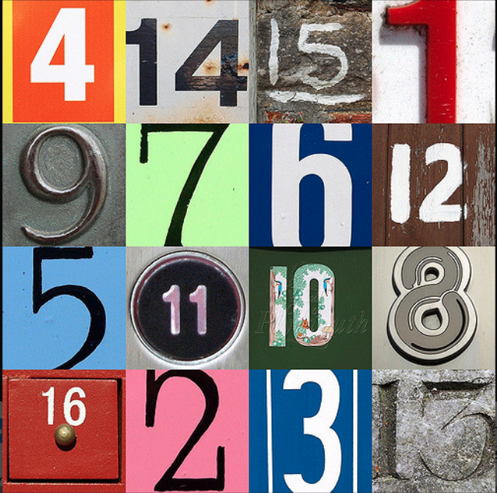
Fair and Square
What can we learn from Magic, Latin and Vedic number squares?
Notes:
Credit Chris/Flickr. https://www.flickr.com/photos/chrisinplymouth/4239651011/

Slide 2
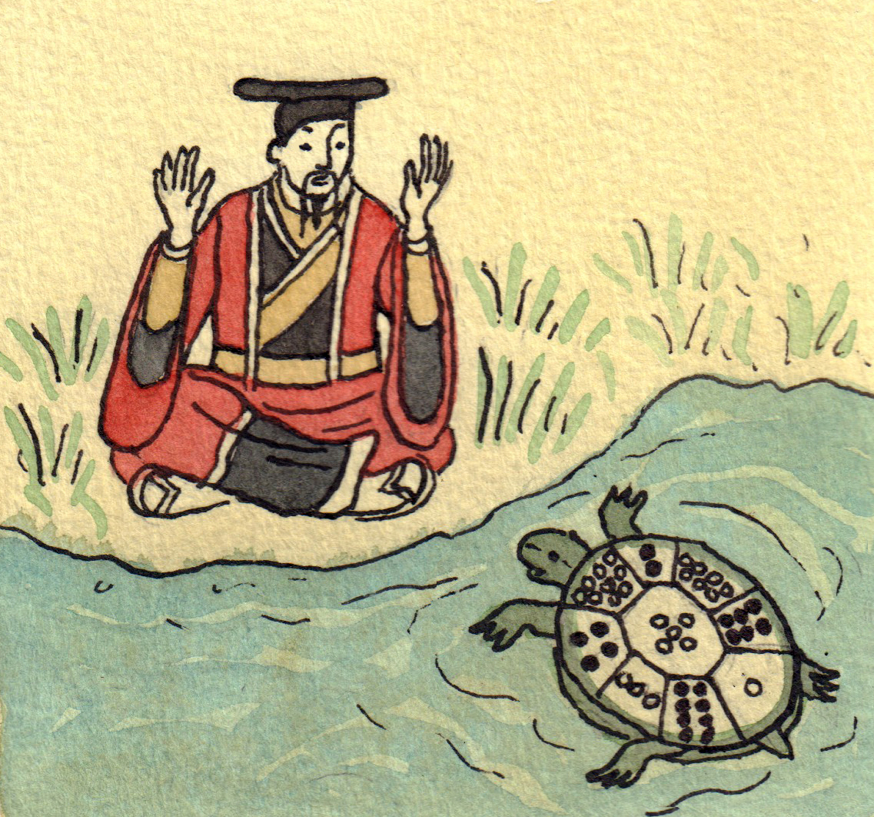
Emperor Yu and the Turtle
Notes:
Chinese literature dating from as early as 2800 BC (some say 640BC) tells the legend of Lo Shu or "scroll of the river Lo". In ancient China, there was a huge flood. The people tried to offer some sacrifice to the river god of one of the flooding rivers, the Lo river, to calm his anger. Then, there emerged from the water a turtle with a curious figure/pattern on its shell, which at the time was considered to be a very good omen. It is also known as laxmi yantra in India. This square was remarkable because every horizontal, vertical, and diagonal row added up to 15. Fifteen is the number of days between the new moon and full moon respectively. The number five was highly regarded in ancient china and this magic square contained a five number in the center of this lo-shu grid.

Slide 3
Latin Squares made from 4, 5 and 6
4 | 6 | 5 |  | 5 | 6 | 4 |  | 5 | 4 | 6
6 | 5 | 4 |  | 4 | 5 | 6 |  | 6 | 5 | 4
5 | 4 | 6 |  | 6 | 4 | 5 |  | 4 | 6 | 5
What patterns do you notice?
Can anymore different squares be made with these numbers?

Slide 4
Can you find a quick way of adding all these numbers together?
1 2 3 4 5 6 7 8 9
total = ?
Notes:
Carl Friedrich Gauss (1777-1855) is recognised as being one of the greatest mathematicians of all time. He showed amazing mathematical skill from an early age, and there are many stories which show how clever he could be.
The most well-known story is a tale from when Gauss was still at primary school. One day Gauss' teacher asked his class to add together all the numbers from1 to 100, assuming that this task would occupy them for quite a while. He was shocked when young Gauss, after a few seconds thought, wrote down the answer - 5050. The teacher couldn't understand how his pupil had calculated the sum so quickly in his head, but the eight year old Gauss pointed out that the problem was actually quite simple.

Slide 5
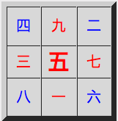
How many ways can you arrange the numbers so that the rows, columns and diagonals still add up to 15?
(15 is known as the ‘magic constant’.)
The Luo Shu Magic Square
4 | 9 | 2
3 | 5 | 7
8 | 1 | 6
Notes:
(Rotation and reflection only)
What do you notice about the Chinese numbers?

Slide 6
What do you notice about these variations?
4 | 9 | 2 |  | 8 | 3 | 4 |  | 6 | 1 | 8 |  | 2 | 7 | 6
3 | 5 | 7 |  | 1 | 5 | 9 |  | 7 | 5 | 3 |  | 9 | 5 | 1
8 | 1 | 6 |  | 6 | 7 | 2 |  | 2 | 9 | 4 |  | 4 | 3 | 8
8 | 1 | 6 |  | 6 | 7 | 2 |  | 2 | 9 | 4 |  | 4 | 3 | 8
3 | 5 | 7 |  | 1 | 5 | 9 |  | 7 | 5 | 3 |  | 9 | 5 | 1
4 | 9 | 2 |  | 8 | 3 | 4 |  | 6 | 1 | 8 |  | 2 | 7 | 6

Slide 7
Luo Shu Magic Square with 5 taken from each number
-1 | +4 | -3
-2 | 0 | +2
+3 | -4 | +1
What do you notice about this pattern?
Notes:
What do you notice about the pattern

Slide 8
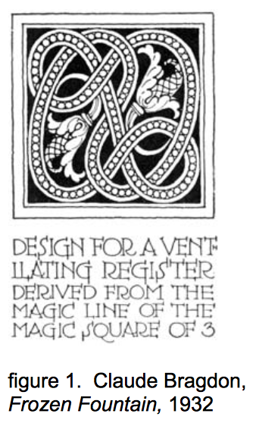
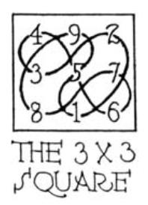
What patterns can be found in the Luo Shu Square?

Slide 9
What patterns can be found in the Luo Shu Square?
4 | 9 | 2
3 | 5 | 7
8 | 1 | 6
8 | 3 | 4
1 | 5 | 9
6 | 7 | 2

Slide 10
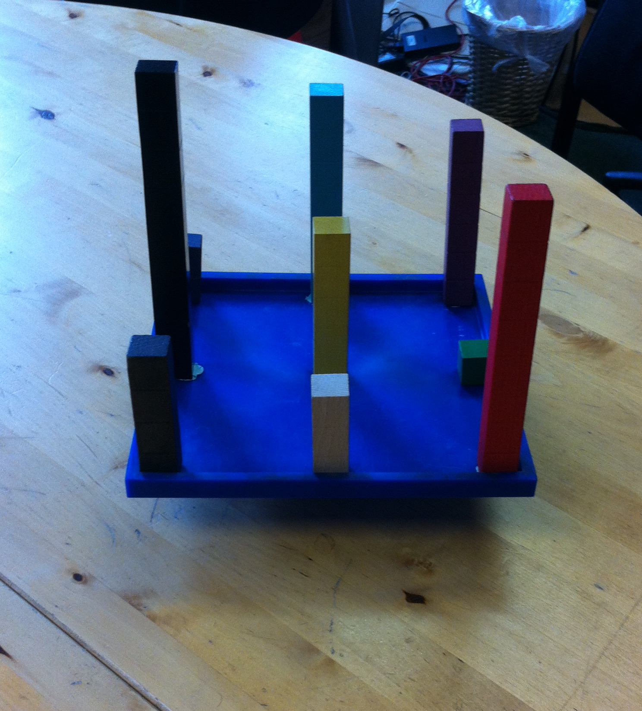
Balancing a magic square, can it be done?

Slide 11
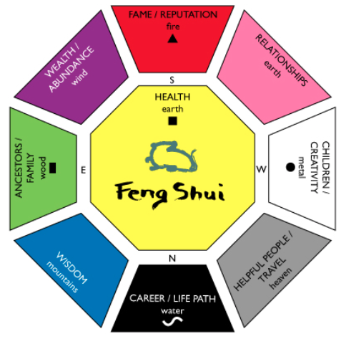
Feng Shui Bagua
Turn the paper until ‘fire’ is pointing south. Look at the Bagua octagon and the classroom. Do you notice any correspondences? The bagua is also about balancing 8 different areas of life.
Notes:
Shandi Greve Penrod (CC) More information on Feng Shui can be found here: http://www.chinasage.info/fengshui.htm

Slide 12
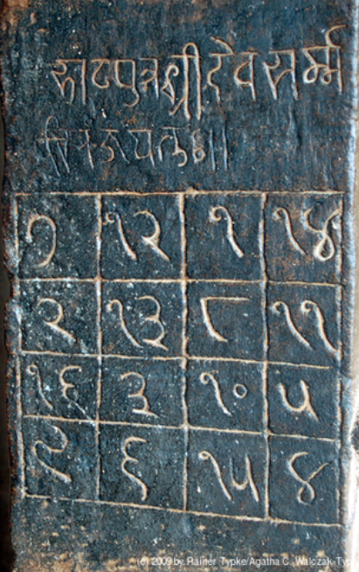
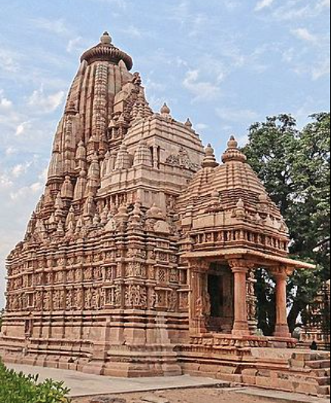
The one thousand year old Jaina square from Parshvanatha temple in Madhya Pradesh in India. Do you recognise any of the numbers?
7 | 12 | 1 | 14
2 | 13 | 8 | 11
16 | 3 | 10 | 5
9 | 6 | 15 | 4
What is the magic constant? In how many ways can you reach it?
Notes:
The 2 and the 3 are used in the west came from Indian numerals (the numerals of this square are in Gurmukhi script)
The magic constant of 34 can be obtained in 52 different geometric ways by adding up:
rows and columns (8)
any two pairs of opposite corners of 3-by-3 squares (28) - includes the two diagonals, six broken diagonals and four 3-by-3 squares
each of the 2-by-2 squares within it (9)
the four corners of the whole square (1)
a pair of adjacent numbers on the top row, plus the corresponding pair on the bottom, and similarly on the sides (6)
Jean-Pierre Dalbéra (Temple picture). RainerTypke (Jaina Square picture)

Slide 13
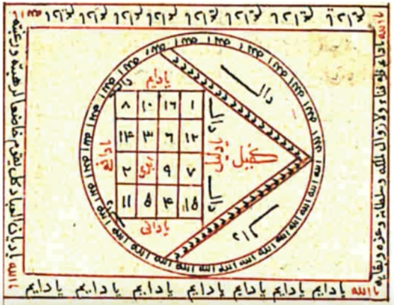
An Islamic magic square from the Shams al-Ma'arif by Ahmed al-Buni 1225CE
Do you recognise any of the numbers in the square?
8 | 11 | 15 | 1
14 | 2 | 7 | 12
3 | 17 | 9 | 6
10 | 5 | 4 | 16
What is the magic constant? (Add up any one of the straight lines of numbers to find this.) In how many ways can you reach it?
Notes:
Shams al-Ma'arif
The Arabic designation for magic squares is wafq al-a'dad which translates as harmonious disposition of the numbers
The 1 and the 9 are used in the west came from Eastern Arabic numerals. https://en.wikipedia.org/wiki/Arabic_numerals#/media/File:Numeration-brahmi_fr.png
Ahmed al-Buni was from north Africa and may have been influenced by the western arabic script where the 7 comes from.
The magic constant of 35 can be obtained in many ways, including by adding up each of the 2x2 corner squares and middle square, as well as totaling a column, row or diagonal.

Slide 14
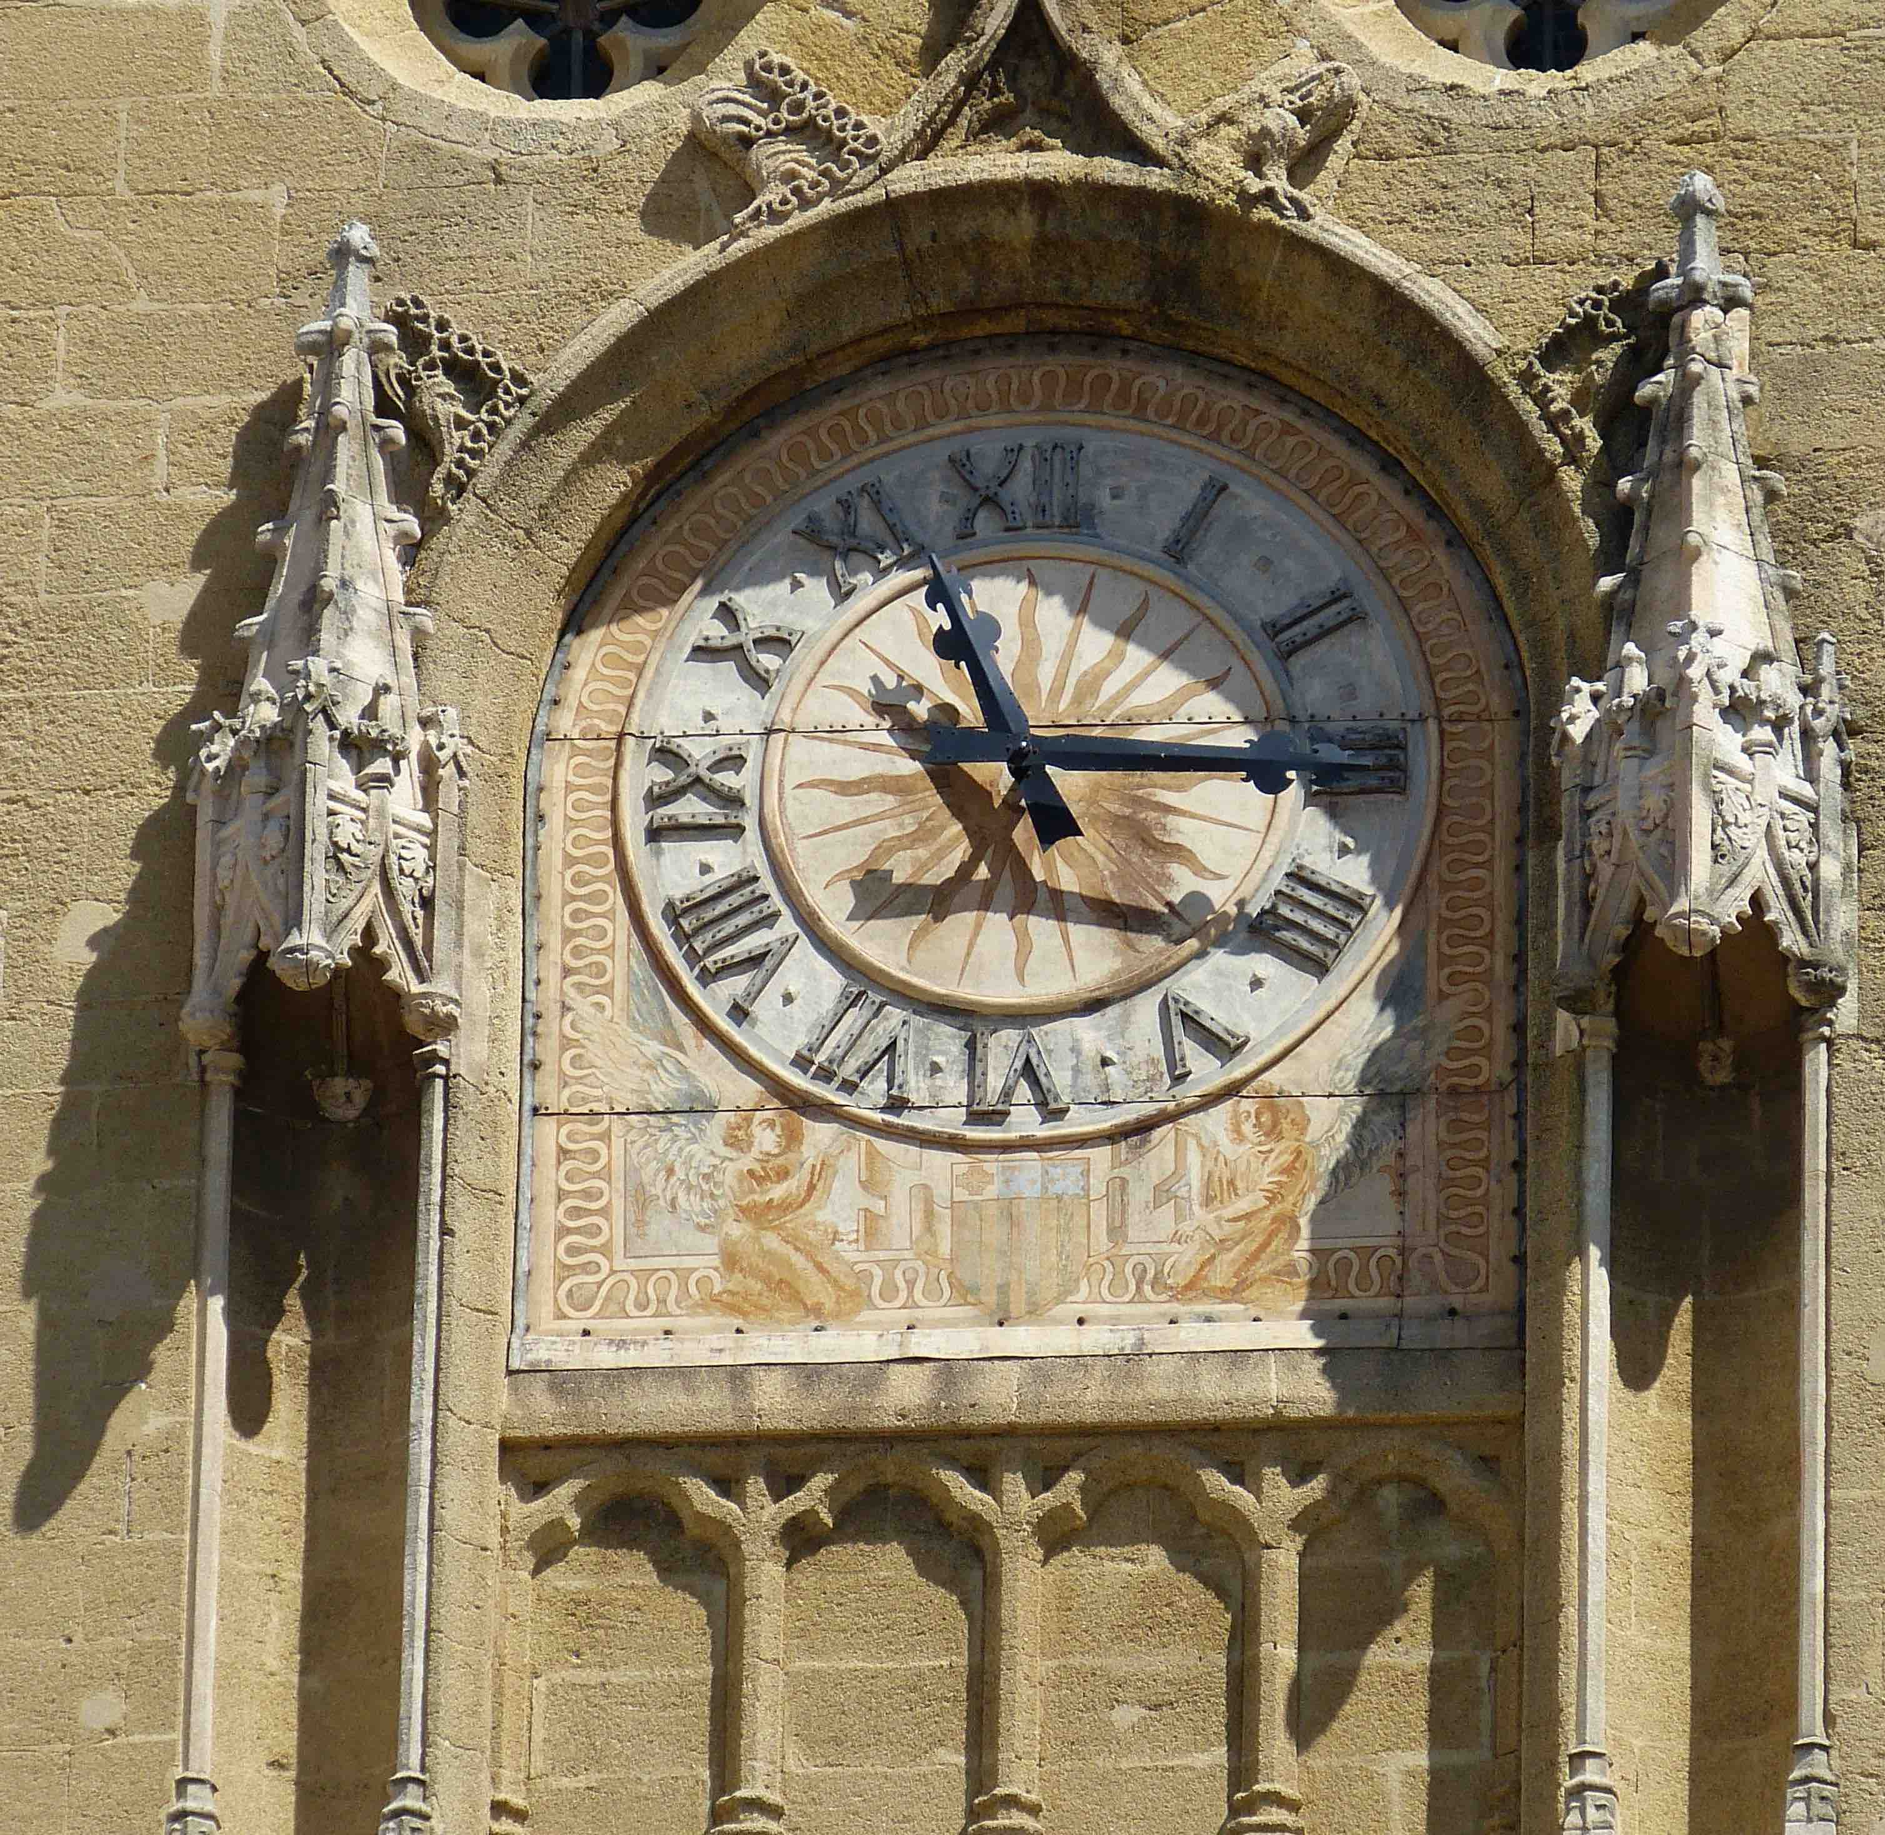
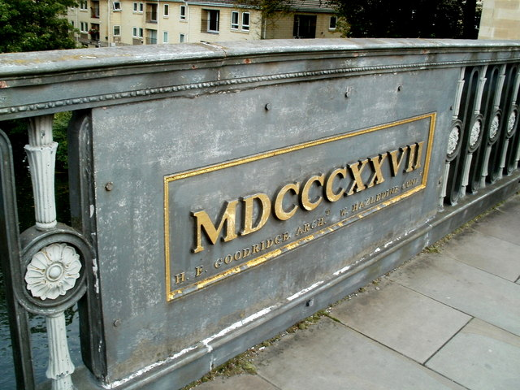
What numerals were being used in Europe at this time?
And even more recently. Can anyone work out what year this is? (M=1000, D=500, C= 100, X=10, V=5, I=1)
Notes:
Roman numerals illustrated in a French clock tower (Provence) and a date on a bridge in Bath, UK
Imagine doing sums with these numbers.
Clock tower CC0 Public Domain
Cleveland Bridge plaque, Bath (1827)
cc-by-sa/2.0 - © Jaggery - geograph.org.uk/p/3346422

Slide 15
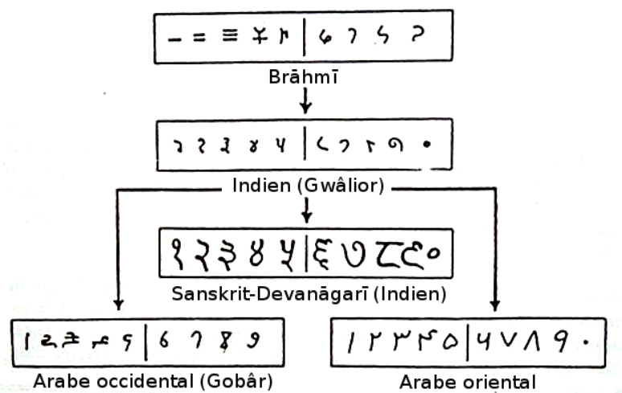
How the numbers we use reached Europe.
Fibonacci, from Pisa (which is now in Italy) spent time in North Africa where he learnt about how effective the system of numbers used by the Arabs was. The numbers originally came from India. He published a book in 1202CE and the numbers gradually got taken up in Europe.
Notes:
This can be followed up with the Children’s book ‘Blockhead, the life of Fibonacci’ by Joseph D’Agnese and John O’Brien. Henry Holt Publishers ISBN 978-0-8050-6305-9

Slide 16
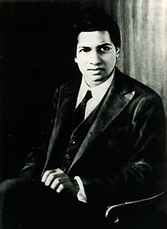
Srinivasa Ramanujan
(1887 – 1920)
An Indian mathematical genius who although had
almost no training in mathematics, found solutions
to problems considered to be unsolvable. He often
said ‘An equation for me has no meaning unless it
represents a thought of God’. He was invited to
come to Cambridge by the mathematician Prof. Godfrey Hardy.
Hardy remembers once going to see him when he was ill in hospital. ‘I had ridden in taxi cab number 1729 and remarked that the number seemed to me rather a dull one, and that I hoped it was not an unfavorable omen. "No", he replied, "it is a very interesting number; it is the smallest number expressible as the sum of two cubes in two different ways.“’
Every positive integer was said to be one of his personal friends. His magic square appears on the next slide.
Notes:
The two different ways of making 1729 :
1729 = 1³ + 12³ = 9³ + 10³.

Slide 17
DD | MM | CC | YY
YY+1 | CC-1 | MM-3 | DD+3
MM-2 | DD+2 | YY+2 | CC-2
CC+1 | YY-1 | DD+1 | MM-1
Notes:
Give out squared paper

Slide 18
DD | MM | CC | YY
22 | 12 | 18 | 87
88 | 17 | 9 | 25
10 | 24 | 89 | 16
19 | 86 | 23 | 11

Slide 19
DD | MM | CC | YY
22 | 12 | 18 | 87 | 139
88 | 17 | 9 | 25 | 139
10 | 24 | 89 | 16 | 139
19 | 86 | 23 | 11 | 139
139 | 139 | 139 | 139 | 139

Slide 20
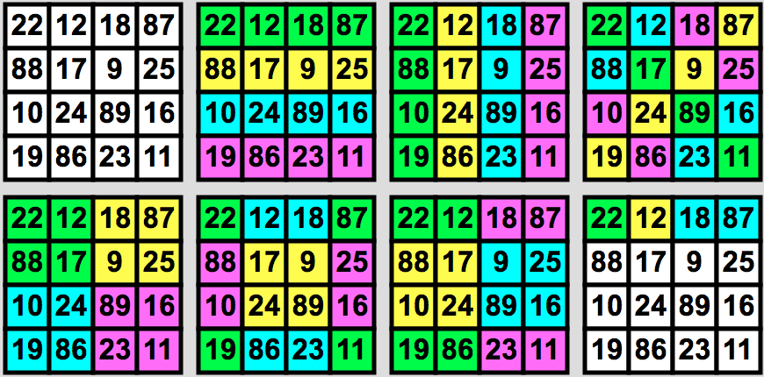
How many other ways can you find to reach 139 in Ramanujan’s magic square?
Notes:
What do you notice about the pattern

Slide 21
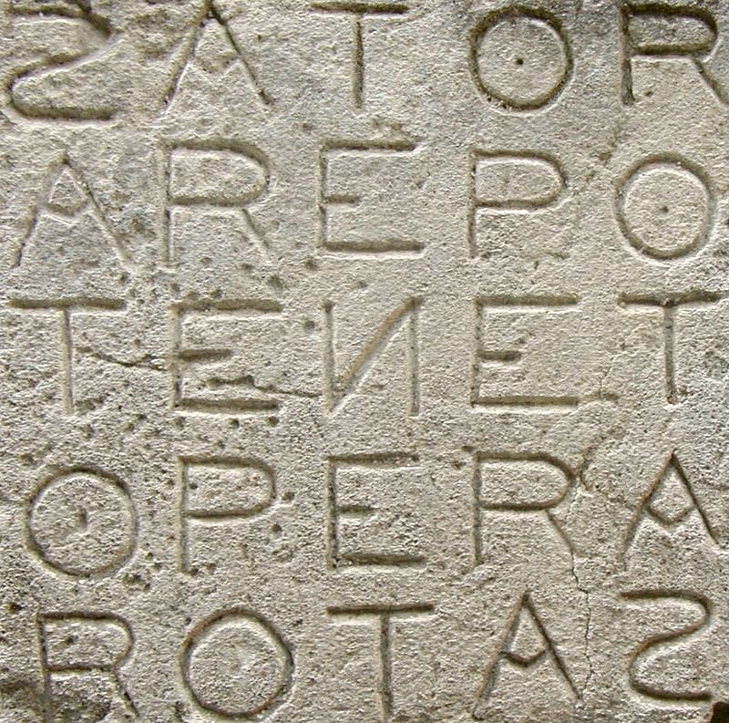
What do you notice about the pattern of the words in this Roman inscription?
Does this follow the rules of a magic number square?
Notes:
The Sator Square is the earliest dateable 2D palindrome. It was found in the ruins of Pompeii, at Herculaneum, a city buried in the ash of Mount Vesuvius in 79 AD. It consists of a sentence written in Latin: "Sator Arepo Tenet Opera Rotas.” A couple of possible meanings are: ‘the farmer uses his plough as his form of work’ or ‘The sower works for mastery by turning the wheel.’

Slide 22
Latin Square
1 | 2 | 3
3 | 1 | 2
2 | 3 | 1
Notes:
In a Latin Square numbers appear as many times in the square as the length of one of the sides of the square (ie 3 in the example above), but numbers are arranged in such a way that no row or column contains the same number more than once.

Slide 23
You can make puzzles from Latin squares called Sudokus. A good Sudoku is one that has a unique solution.
Two of these are good Sudokus but one has more than one (apparent) solution.
Which one?
Mathematicians would probably call all these solutions the same.
Why?
Do you agree?
1
 |  | 3
1 | 3
1
 | 3

Slide 24
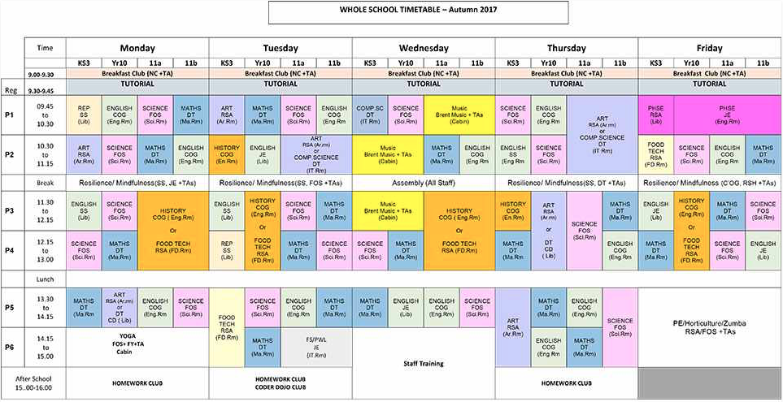
Look at your school timetable. Notice how it works like a Latin Square (with each teacher and class appearing only once in each time slot on a given day)
Notes:
Look at your school timetable. Notice how it works like a Latin Square (with each teacher and class appearing only once in each time slot on a given day). What else could be usefully planned in this way?

Slide 25
Sudoku 2
Can you fill this 9×9 grid with numbers so that each row, column and 3×3 section (marked in grey or white) contains all of the digits between 1 and 9?
2 |  | 9 | 1 |  | 4 | 5 |  | 7
8 |  |  |  | 7 | 9 | 2 | 1
6 |  | 7 | 3 |  | 2 | 4 | 8
9 |  | 3 | 8 |  | 5 | 7 |  | 1
4 |  |  | 2 | 6 |  |  | 3
1 | 8 |  |  | 9 |  | 6
7 |  | 1 |  | 2 |  | 3 |  | 6
 | 9 |  | 4 |  |  | 1
3 |  | 6 | 9 |  | 7 |  | 5 | 4
Notes:
The Sudoku is a 9x9 Latin Square. Some Sudokus can be made up of magic squares: http://www.sachsentext.de/en/node/825

Slide 26
What do you notice about the numbers in this square?
Making a Vedic Square
0 | 1 | 2 | 3 | 4
1 | 1 | 2 | 3 | 4
2 | 2 | 4 | 6 | 8
3 | 3 | 6 | 9 | 3
4 | 4 | 8 | 3 | 7
0 | 1 | 2 | 3 | 4
1 | 1 | 2 | 3 | 4
2 | 2 | 4 | 6 | 8
3 | 3 | 6 | 9 | 3
4 | 4 | 8 | 3 | 7
But where did the 3s and the 7 in the bottom right hand corner come from ... ?
Notes:
What happens if you add the 1 to the 2 of 12? or if you add the 1 to the 6 of 16?
This is called a ‘digital root’ obtained by adding two digits (or more) together until there is just a single digit.

Slide 27
Vedic Square
0 | 1 | 2 | 3 | 4 | 5 | 6 | 7 | 8 | 9
1 | 1 | 2 | 3 | 4 | 5 | 6 | 7 | 8 | 9
2 | 2 | 4 | 6 | 8 | 1 | 3 | 5 | 7 | 9
3 | 3 | 6 | 9 | 3 | 6 | 9 | 3 | 6 | 9
4 | 4 | 8 | 3 | 7 | 2 | 6 | 1 | 5 | 9
5 | 5 | 1 | 6 | 2 | 7 | 3 | 8 | 4 | 9
6 | 6 | 3 | 9 | 6 | 3 | 9 | 6 | 3 | 9
7 | 7 | 5 | 3 | 1 | 8 | 6 | 4 | 2 | 9
8 | 8 | 7 | 6 | 5 | 4 | 3 | 2 | 1 | 9
9 | 9 | 9 | 9 | 9 | 9 | 9 | 9 | 9 | 9
Can you fill in the missing numbers of this Vedic Square by multiplying the numbers in each column and row heading and then adding together any two digit number answers?
0 | 1 | 2 | 3 | 4 | 5 | 6 | 7 | 8 | 9
1 | 1 | 2 | 3 | 4
2 | 2 | 4 | 6 | 8
3 | 3 | 6 | 9 | 3
4 | 4 | 8 | 3 | 7
5
6
7
8
9
Notes:
What number sequences and patterns can pupils notice?
The first row and column goes from 1 – 8
The eighth row and column is the reverse of the first row and column
The second row (and column) is even numbers 2, 4, 6, 8 and then odd numbers 1, 3, 5, 7.
The seventh row (and column) is the reverse of the second row (and column).
The third row and column goes up in threes: 3, 6, 9, 3, 6, 9.
The sixth row and column is the reverse of the third row and column.
The fourth row and column has a pattern of two ascending even numbers alternating with ascending odd numbers
The fifth row and column is the reverse of the fourth row and column.
Each diagonal has reflectional symmetry

Slide 28
Making patterns using the Vedic Square
Join all the 1s together using straight lines. Repeat this with other numbers using different coloured crayons. What patterns do you notice?
0 | 1 | 2 | 3 | 4 | 5 | 6 | 7 | 8 | 9
1 | 1 | 2 | 3 | 4 | 5 | 6 | 7 | 8 | 9
2 | 2 | 4 | 6 | 8 | 1 | 3 | 5 | 7 | 9
3 | 3 | 6 | 9 | 3 | 6 | 9 | 3 | 6 | 9
4 | 4 | 8 | 3 | 7 | 2 | 6 | 1 | 5 | 9
5 | 5 | 1 | 6 | 2 | 7 | 3 | 8 | 4 | 9
6 | 6 | 3 | 9 | 6 | 3 | 9 | 6 | 3 | 9
7 | 7 | 5 | 3 | 1 | 8 | 6 | 4 | 2 | 9
8 | 8 | 7 | 6 | 5 | 4 | 3 | 2 | 1 | 9
9 | 9 | 9 | 9 | 9 | 9 | 9 | 9 | 9 | 9

Slide 29
0 | 1 | 2 | 3 | 4 | 5 | 6 | 7 | 8 | 9
1 | 1 | 2 | 3 | 4 | 5 | 6 | 7 | 8 | 9
2 | 2 | 4 | 6 | 8 | 1 | 3 | 5 | 7 | 9
3 | 3 | 6 | 9 | 3 | 6 | 9 | 3 | 6 | 9
4 | 4 | 8 | 3 | 7 | 2 | 6 | 1 | 5 | 9
5 | 5 | 1 | 6 | 2 | 7 | 3 | 8 | 4 | 9
6 | 6 | 3 | 9 | 6 | 3 | 9 | 6 | 3 | 9
7 | 7 | 5 | 3 | 1 | 8 | 6 | 4 | 2 | 9
8 | 8 | 7 | 6 | 5 | 4 | 3 | 2 | 1 | 9
9 | 9 | 9 | 9 | 9 | 9 | 9 | 9 | 9 | 9

Slide 30
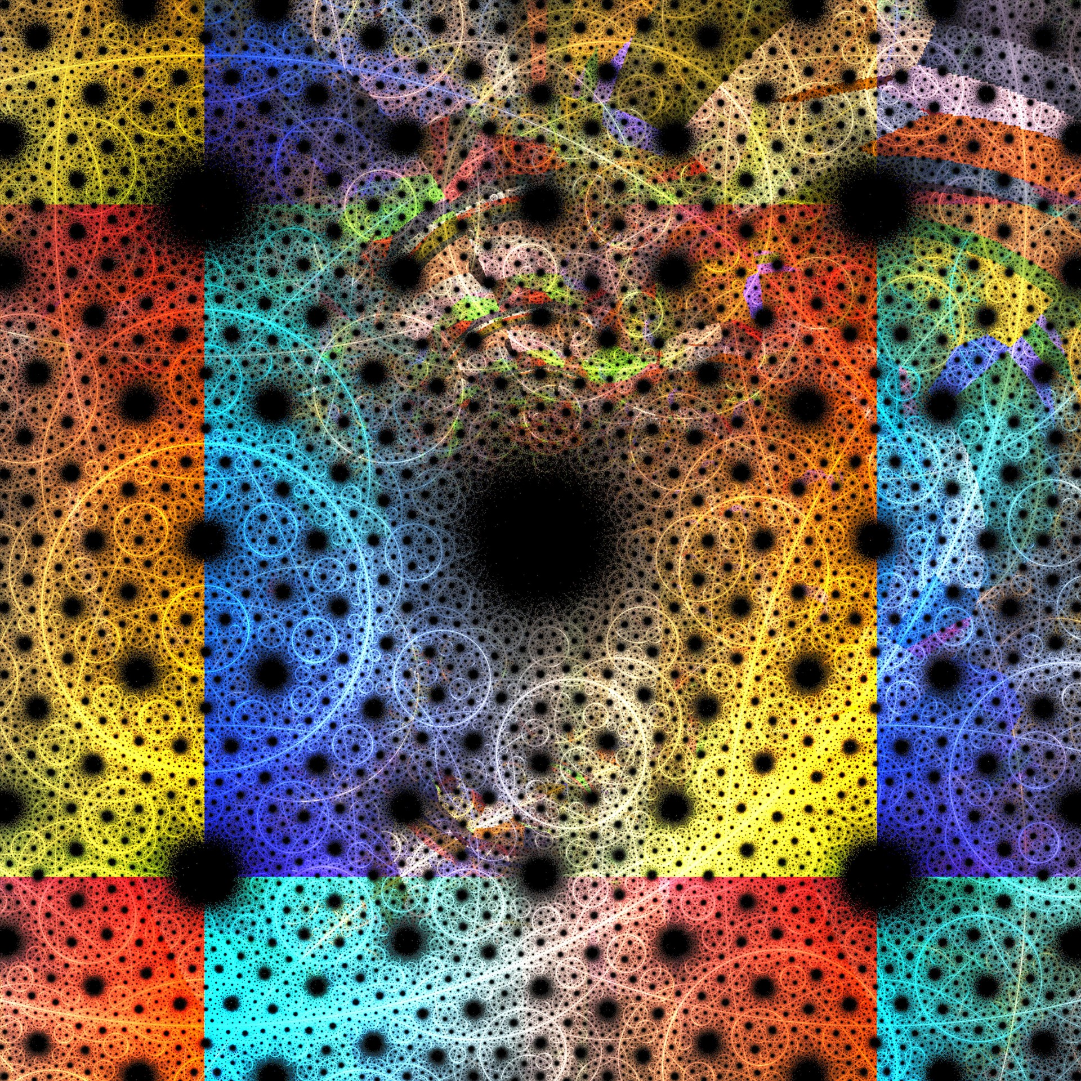
The Magic of Magic Squares
Notes:
Publicdomainpictures.net

Slide 31
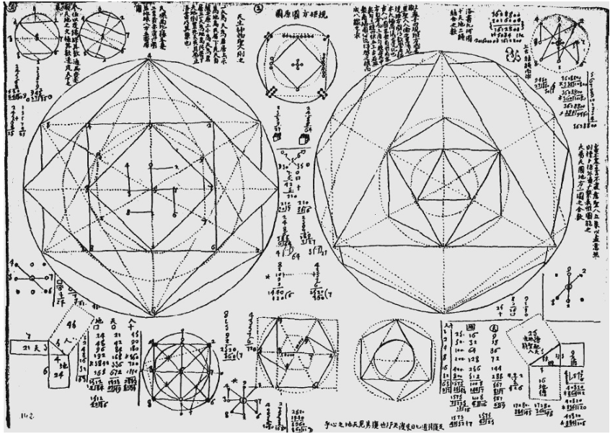
For thousands of years people from different cultures across the world have been trying to understand patterns in nature, the seasons, the climate. Knowing patterns allows people to know when is best to plant or to prepare for winter. Even where to live and how to live. They used numbers, sometimes arranged in structures like Magic Squares, to try to help them. They carved them into temples, some even wore them round their necks. Even though they understood them in different ways they believed that they held power.
Here are some drawings by Jesuit Missionaries from Europe in China in 1668 who were trying to understand the Luo Shu Magic Square by joining up the numbers in different ways.
Notes:
The odd numbers are connected in a circle, the symbol of heaven.
The even numbers make the four corners of a square, the symbol of earth.

Slide 32
Further investigations with Magic Squares. This is a 9 x 9 Magic Square with its digital root numbers (as used in Vedic Squares) in the square below. What do you notice about the number patterns?
47 | 58 | 69 | 80 | 1 | 12 | 23 | 34 | 45
57 | 68 | 79 | 9 | 11 | 22 | 33 | 44 | 46
67 | 78 | 8 | 10 | 21 | 32 | 43 | 54 | 56
77 | 7 | 18 | 20 | 31 | 42 | 53 | 55 | 66
6 | 17 | 19 | 30 | 41 | 52 | 63 | 65 | 76
16 | 27 | 29 | 40 | 51 | 62 | 64 | 75 | 5
26 | 28 | 39 | 50 | 61 | 72 | 74 | 4 | 15
36 | 38 | 49 | 60 | 71 | 73 | 3 | 14 | 25
37 | 48 | 59 | 70 | 81 | 2 | 13 | 24 | 35
2 | 4 | 6 | 8 | 1 | 3 | 5 | 7 | 9
3 | 5 | 7 | 9 | 2 | 4 | 6 | 8 | 1
4 | 6 | 8 | 1 | 3 | 5 | 7 | 9 | 2
5 | 7 | 9 | 2 | 4 | 6 | 8 | 1 | 3
6 | 8 | 1 | 3 | 5 | 7 | 9 | 2 | 4
7 | 9 | 2 | 4 | 6 | 8 | 1 | 3 | 5
8 | 1 | 3 | 5 | 7 | 9 | 2 | 4 | 6
9 | 2 | 4 | 6 | 8 | 1 | 3 | 5 | 7
1 | 3 | 5 | 7 | 9 | 2 | 4 | 6 | 8
How was the second square made from the first one?
Notes:
Created using the Siamese method. See: https://www.magischvierkant.com/two-dimensional-eng/9x9/siamese-method/

Slide 33
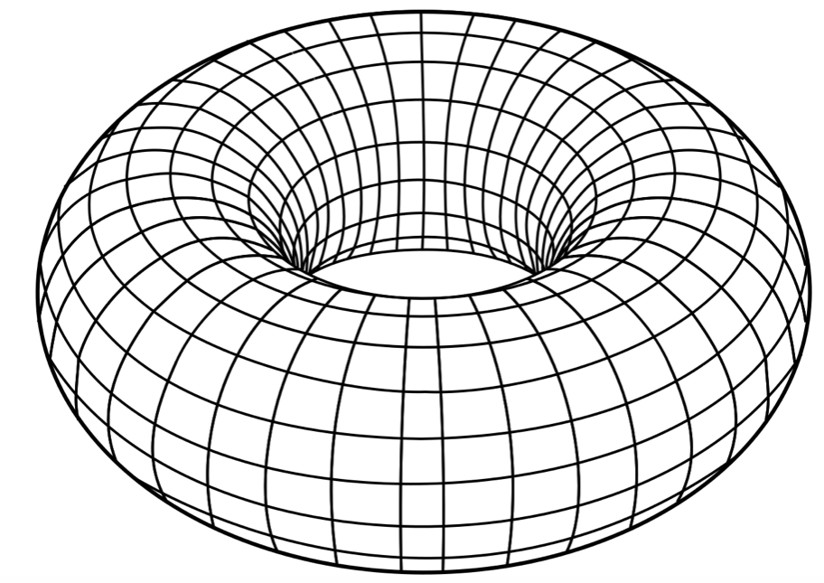
When Magic Squares like this are folded they create a doughnut shape known as a ‘Torus’. High quality electric transformers are made from these shapes. The ‘harmonious’ shape is very effective for making sure that electrical energy is not wasted.
Notes:
Another formula for constructing a 3x3 magic square of the Luo Shu format is given below. This can also be experimented with.
y-1 x² y-x
x y 2y-x
x+y 1 y+1
When this method is used to create 9x9 and 27x27 magic squares, claims have been made about their potential application to electrical engineering (through their use in the formation of toruses (‘doughnut’ shapes that offer the least resistance to electricity - useful as electrical transformers).

Slide 34
Certain numbers have been marked on this 27 x 27 Magic Square.
352 | 717 | 326 | 691 | 300 | 665 | 274 | 639 | 248 | 613 | 222 | 587 | 196 | 561 | 170 | 535 | 144 | 509 | 118 | 483 | 92 | 457 | 66 | 431 | 40 | 405 | 14
15 | 353 | 718 | 327 | 692 | 301 | 666 | 275 | 640 | 249 | 614 | 223 | 588 | 197 | 562 | 171 | 536 | 145 | 510 | 119 | 484 | 93 | 458 | 67 | 432 | 41 | 379
380 | 16 | 354 | 719 | 328 | 693 | 302 | 667 | 276 | 641 | 250 | 615 | 224 | 589 | 198 | 563 | 172 | 537 | 146 | 511 | 120 | 485 | 94 | 459 | 68 | 406 | 42
43 | 381 | 17 | 355 | 720 | 329 | 694 | 303 | 668 | 277 | 642 | 251 | 616 | 225 | 590 | 199 | 564 | 173 | 538 | 147 | 512 | 121 | 486 | 95 | 433 | 69 | 407
408 | 44 | 382 | 18 | 356 | 721 | 330 | 695 | 304 | 669 | 278 | 643 | 252 | 617 | 226 | 591 | 200 | 565 | 174 | 539 | 148 | 513 | 122 | 460 | 96 | 434 | 70
71 | 409 | 45 | 383 | 19 | 357 | 722 | 331 | 696 | 305 | 670 | 279 | 644 | 253 | 618 | 227 | 592 | 201 | 566 | 175 | 540 | 149 | 487 | 123 | 461 | 97 | 435
436 | 72 | 410 | 46 | 384 | 20 | 358 | 723 | 332 | 697 | 306 | 671 | 280 | 645 | 254 | 619 | 228 | 593 | 202 | 567 | 176 | 514 | 150 | 488 | 124 | 462 | 98
99 | 437 | 73 | 411 | 47 | 385 | 21 | 359 | 724 | 333 | 698 | 307 | 672 | 281 | 646 | 255 | 620 | 229 | 594 | 203 | 541 | 177 | 515 | 151 | 489 | 125 | 463
464 | 100 | 438 | 74 | 412 | 48 | 386 | 22 | 360 | 725 | 334 | 699 | 308 | 673 | 282 | 647 | 256 | 621 | 230 | 568 | 204 | 542 | 178 | 516 | 152 | 490 | 126
127 | 465 | 101 | 439 | 75 | 413 | 49 | 387 | 23 | 361 | 726 | 335 | 700 | 309 | 674 | 283 | 648 | 257 | 595 | 231 | 569 | 205 | 543 | 179 | 517 | 153 | 491
492 | 128 | 466 | 102 | 440 | 76 | 414 | 50 | 388 | 24 | 362 | 727 | 336 | 701 | 310 | 675 | 284 | 622 | 258 | 596 | 232 | 570 | 206 | 544 | 180 | 518 | 154
155 | 493 | 129 | 467 | 103 | 441 | 77 | 415 | 51 | 389 | 25 | 363 | 728 | 337 | 702 | 311 | 649 | 285 | 623 | 259 | 597 | 233 | 571 | 207 | 545 | 181 | 519
520 | 156 | 494 | 130 | 468 | 104 | 442 | 78 | 416 | 52 | 390 | 26 | 364 | 729 | 338 | 676 | 312 | 650 | 286 | 624 | 260 | 598 | 234 | 572 | 208 | 546 | 182
183 | 521 | 157 | 495 | 131 | 469 | 105 | 443 | 79 | 417 | 53 | 391 | 27 | 365 | 703 | 339 | 677 | 313 | 651 | 287 | 625 | 261 | 599 | 235 | 573 | 209 | 547
548 | 184 | 522 | 158 | 496 | 132 | 470 | 106 | 444 | 80 | 418 | 54 | 392 | 1 | 366 | 704 | 340 | 678 | 314 | 652 | 288 | 626 | 262 | 600 | 236 | 574 | 210
211 | 549 | 185 | 523 | 159 | 497 | 133 | 471 | 107 | 445 | 81 | 419 | 28 | 393 | 2 | 367 | 705 | 341 | 679 | 315 | 653 | 289 | 627 | 263 | 601 | 237 | 575
576 | 212 | 550 | 186 | 524 | 160 | 498 | 134 | 472 | 108 | 446 | 55 | 420 | 29 | 394 | 3 | 368 | 706 | 342 | 680 | 316 | 654 | 290 | 628 | 264 | 602 | 238
239 | 577 | 213 | 551 | 187 | 525 | 161 | 499 | 135 | 473 | 82 | 447 | 56 | 421 | 30 | 395 | 4 | 369 | 707 | 343 | 681 | 317 | 655 | 291 | 629 | 265 | 603
604 | 240 | 578 | 214 | 552 | 188 | 526 | 162 | 500 | 109 | 474 | 83 | 448 | 57 | 422 | 31 | 396 | 5 | 370 | 708 | 344 | 682 | 318 | 656 | 292 | 630 | 266
267 | 605 | 241 | 579 | 215 | 553 | 189 | 527 | 136 | 501 | 110 | 475 | 84 | 449 | 58 | 423 | 32 | 397 | 6 | 371 | 709 | 345 | 683 | 319 | 657 | 293 | 631
632 | 268 | 606 | 242 | 580 | 216 | 554 | 163 | 528 | 137 | 502 | 111 | 476 | 85 | 450 | 59 | 424 | 33 | 398 | 7 | 372 | 710 | 346 | 684 | 320 | 658 | 294
295 | 633 | 269 | 607 | 243 | 581 | 190 | 555 | 164 | 529 | 138 | 503 | 112 | 477 | 86 | 451 | 60 | 425 | 34 | 399 | 8 | 373 | 711 | 347 | 685 | 321 | 659
660 | 296 | 634 | 270 | 608 | 217 | 582 | 191 | 556 | 165 | 530 | 139 | 504 | 113 | 478 | 87 | 452 | 61 | 426 | 35 | 400 | 9 | 374 | 712 | 348 | 686 | 322
323 | 661 | 297 | 635 | 244 | 609 | 218 | 583 | 192 | 557 | 166 | 531 | 140 | 505 | 114 | 479 | 88 | 453 | 62 | 427 | 36 | 401 | 10 | 375 | 713 | 349 | 687
688 | 324 | 662 | 271 | 636 | 245 | 610 | 219 | 584 | 193 | 558 | 167 | 532 | 141 | 506 | 115 | 480 | 89 | 454 | 63 | 428 | 37 | 402 | 11 | 376 | 714 | 350
351 | 689 | 298 | 663 | 272 | 637 | 246 | 611 | 220 | 585 | 194 | 559 | 168 | 533 | 142 | 507 | 116 | 481 | 90 | 455 | 64 | 429 | 38 | 403 | 12 | 377 | 715
716 | 325 | 690 | 299 | 664 | 273 | 638 | 247 | 612 | 221 | 586 | 195 | 560 | 169 | 534 | 143 | 508 | 117 | 482 | 91 | 456 | 65 | 430 | 39 | 404 | 13 | 378
What pattern or shape can you see?
Notes:
Pupils should notice an ‘X’ shape which indicates possible harmonic ratios (like musical ratios) appearing within this magic square.
27 x 27 Magic Square constructed using the diagonal method of Yang Hui https://www.magischvierkant.com/two-dimensional-eng/27x27/diagonal-method/

Slide 35
What do you notice about these numbers?
What do you think they represent?
C | G | D | A | E | B | F# | Db
1 | 3 | 9 | 27 | 81 | 243 | 729 | 2187
2 | 6 | 18 | 54 | 162 | 486 | 1458 | 4374
4 | 12 | 36 | 108 | 324 | 972 | 2916 | 8748
8 | 24 | 72 | 216 | 648 | 1944 | 5832 | 17496
16 | 48 | 144 | 432 | 1296 | 3888 | 11664 | 34992
32 | 96 | 288 | 864 | 2592 | 7776 | 23328 | 69984
64 | 192 | 576 | 1728 | 5184 | 15552 | 46656 | 139968
128 | 384 | 1152 | 3456 | 10368 | 31104 | 93312 | 279936
256 | 768 | 2304 | 6912 | 20736 | 62208 | 186624
512 | 1536 | 4608 | 13824 | 41472 | 124416
It is these numbers were marked on the magic square in the previous slide.
Notes:
Theses numbers indicate musical scales: Circle of Fifths (in Pythagorian tuning).

Slide 36
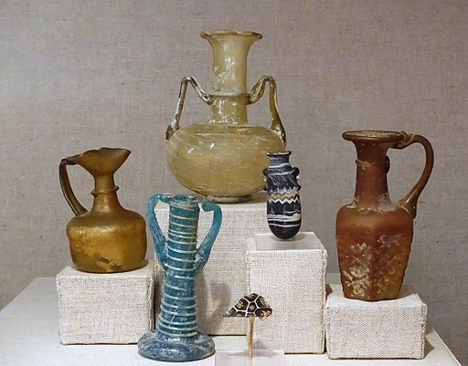
In 587 CE Varahamihira from India described a magic square for making perfumes.
Each cell in the square represents a different ingredient and each number gives the proportion of the ingredient.
A different perfume is created by adding the given volume of each of the four ingredients together along each row, column or diagonal.
What will be the volume of each perfume?
2 | 3 | 5 | 8
5 | 8 | 2 | 3
4 | 1 | 7 | 6
7 | 6 | 4 | 1

Slide 37
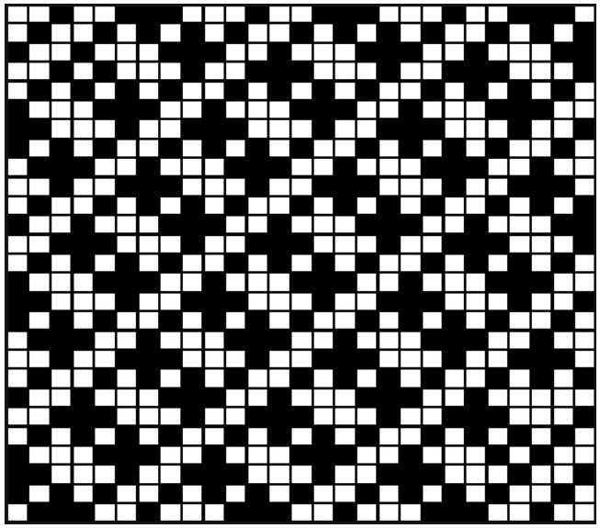
Here is a 27 x 27 Magic Square with the even numbered squares shaded black. What patterns do you notice?
Notes:
Browne’s square digital root.

Slide 38
This pattern was created on this Magic Square by starting at the top left and colouring in the cells of the numbers that are in their correct sequence in yellow (i.e. 1, 4, 5 etc.). The cells with numbers that go in the opposite direction (from bottom right to top left) are coloured in purple.
Try it with one of the two uncoloured 4 x 4 Magic Squares.
1 | 15 | 14 | 4
12 | 6 | 7 | 9
8 | 10 | 11 | 5
13 | 3 | 2 | 16
16 | 2 | 3 | 13
5 | 11 | 10 | 8
9 | 7 | 6 | 12
4 | 14 | 15 | 1
1 | 63 | 62 | 4 | 5 | 59 | 58 | 8
56 | 10 | 11 | 53 | 52 | 14 | 15 | 49
48 | 18 | 19 | 45 | 44 | 22 | 23 | 41
25 | 39 | 38 | 28 | 29 | 35 | 34 | 32
33 | 31 | 30 | 36 | 37 | 27 | 26 | 40
24 | 42 | 43 | 21 | 20 | 46 | 47 | 17
16 | 50 | 51 | 13 | 12 | 54 | 55 | 9
57 | 7 | 6 | 60 | 61 | 3 | 2 | 64
Notes:
Carus Method

Slide 39
Now try doing the same thing with this 8 x 8 Magic Square
1 | 63 | 3 | 61 | 60 | 6 | 58 | 8
56 | 55 | 11 | 12 | 13 | 14 | 50 | 49
17 | 18 | 46 | 45 | 44 | 43 | 23 | 24
40 | 26 | 38 | 28 | 29 | 35 | 31 | 33
32 | 34 | 30 | 36 | 37 | 27 | 39 | 25
41 | 42 | 22 | 21 | 20 | 19 | 47 | 48
16 | 15 | 51 | 52 | 53 | 54 | 10 | 9
57 | 7 | 59 | 5 | 4 | 62 | 2 | 64
1 | 63 | 3 | 61 | 60 | 6 | 58 | 8
56 | 55 | 11 | 12 | 13 | 14 | 50 | 49
17 | 18 | 46 | 45 | 44 | 43 | 23 | 24
40 | 26 | 38 | 28 | 29 | 35 | 31 | 33
32 | 34 | 30 | 36 | 37 | 27 | 39 | 25
41 | 42 | 22 | 21 | 20 | 19 | 47 | 48
16 | 15 | 51 | 52 | 53 | 54 | 10 | 9
57 | 7 | 59 | 5 | 4 | 62 | 2 | 64

Slide 40
Now try doing the same thing with one of these 6 x 6 Magic Squares. This time you will need four different colours and to start looking for numbers going up in sequence starting from each one of the four corner squares.
6 | 32 | 3 | 34 | 35 | 1
7 | 11 | 27 | 28 | 8 | 30
19 | 14 | 16 | 15 | 23 | 24
18 | 20 | 22 | 21 | 17 | 13
25 | 29 | 10 | 9 | 26 | 12
36 | 5 | 33 | 4 | 2 | 31
6 | 32 | 3 | 34 | 35 | 1
7 | 11 | 27 | 28 | 8 | 30
19 | 14 | 16 | 15 | 23 | 24
18 | 20 | 22 | 21 | 17 | 13
25 | 29 | 10 | 9 | 26 | 12
36 | 5 | 33 | 4 | 2 | 31
1 | 5 | 33 | 34 | 32 | 6
30 | 8 | 28 | 9 | 11 | 25
18 | 23 | 15 | 16 | 20 | 19
24 | 14 | 21 | 22 | 17 | 13
7 | 26 | 10 | 27 | 29 | 12
31 | 35 | 4 | 3 | 2 | 36
1 | 5 | 33 | 34 | 32 | 6
30 | 8 | 28 | 9 | 11 | 25
18 | 23 | 15 | 16 | 20 | 19
24 | 14 | 21 | 22 | 17 | 13
7 | 26 | 10 | 27 | 29 | 12
31 | 35 | 4 | 3 | 2 | 36

Slide 41
Other patterns can be seen when the number in the centre of a Magic Square (with an odd number of rows and columns) is reduced to zero (just as was done with the Luo Shu Magic Square in slide 6).
What do you notice?
-9 | 12 | 5 | -2 | -6
1 | 7 | -11 | 4 | -1
-8 | -3 | 0 | 3 | 8
10 | -4 | 11 | -7 | -10
6 | -12 | -5 | 2 | 9
The pattern is a little different if similar opposite pairs of numbers are created with a Magic Square with an even number of rows and columns.
What do you notice?
1 | -3 | 11 | -9
-5 | 7 | -15 | 13
-11 | 9 | -1 | 3
15 | -13 | 5 | -7

Slide 42
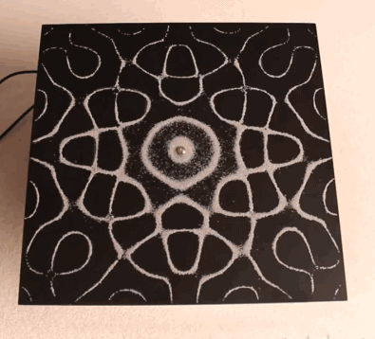
Watch this short film clip on resonance patterns
https://www.youtube.com/watch?v=hIgmiDnmVdU
Notes:
3 mins clip Chladni Patterns

Slide 43
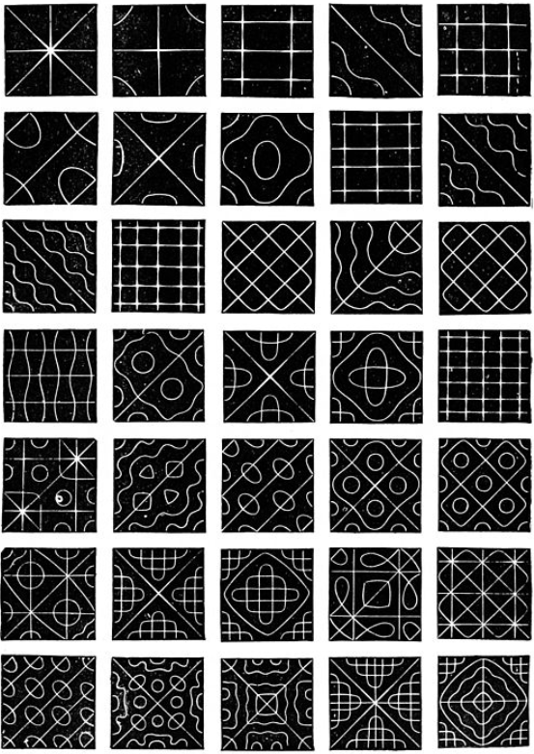
Can you find any similarities between any of the Magic Square patterns and the metal plate resonance patterns?
1 | 63 | 62 | 4 | 5 | 59 | 58 | 8
56 | 10 | 11 | 53 | 52 | 14 | 15 | 49
48 | 18 | 19 | 45 | 44 | 22 | 23 | 41
25 | 39 | 38 | 28 | 29 | 35 | 34 | 32
33 | 31 | 30 | 36 | 37 | 27 | 26 | 40
24 | 42 | 43 | 21 | 20 | 46 | 47 | 17
16 | 50 | 51 | 13 | 12 | 54 | 55 | 9
57 | 7 | 6 | 60 | 61 | 3 | 2 | 64
-9 | 12 | 5 | -2 | -6
1 | 7 | -11 | 4 | -1
-8 | -3 | 0 | 3 | 8
10 | -4 | 11 | -7 | -10
6 | -12 | -5 | 2 | 9
6 | 32 | 3 | 34 | 35 | 1
7 | 11 | 27 | 28 | 8 | 30
19 | 14 | 16 | 15 | 23 | 24
18 | 20 | 22 | 21 | 17 | 13
25 | 29 | 10 | 9 | 26 | 12
36 | 5 | 33 | 4 | 2 | 31
1 | -3 | 11 | -9
-5 | 7 | -15 | 13
-11 | 9 | -1 | 3
15 | -13 | 5 | -7
1 | 63 | 3 | 61 | 60 | 6 | 58 | 8
56 | 55 | 11 | 12 | 13 | 14 | 50 | 49
17 | 18 | 46 | 45 | 44 | 43 | 23 | 24
40 | 26 | 38 | 28 | 29 | 35 | 31 | 33
32 | 34 | 30 | 36 | 37 | 27 | 39 | 25
41 | 42 | 22 | 21 | 20 | 19 | 47 | 48
16 | 15 | 51 | 52 | 53 | 54 | 10 | 9
57 | 7 | 59 | 5 | 4 | 62 | 2 | 64
Notes:
Based on work of Dr Paul Carus (c 1912)

Slide 44
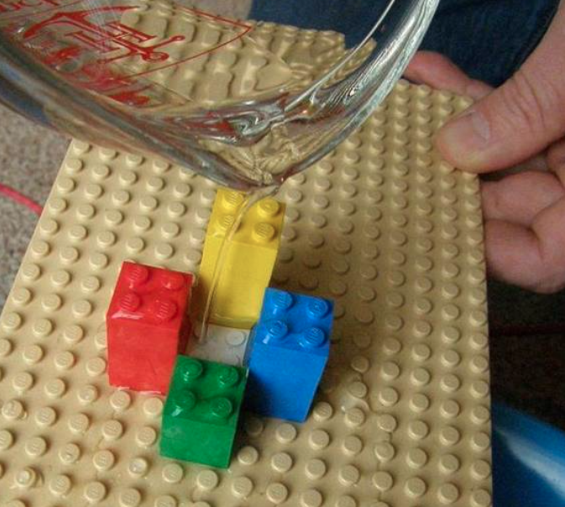
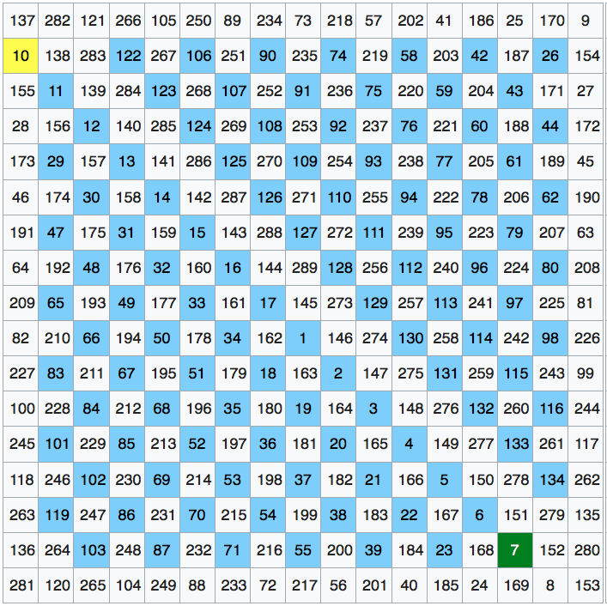
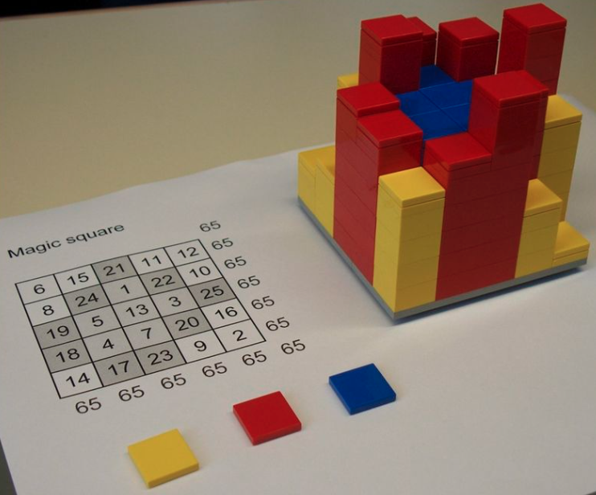
If a Magic Square is made of Lego blocks with higher blocks for larger numbers and water is tipped on it what do you think will happen?
Some Magic Squares, like the one in the second photo will hold a lot of water.
If the Magic Square has been made like the Luo Shu square, only larger, it will contain the most number of ponds. It will lead to a greater spread of water. Perhaps if it were a landscape it would lead to less serious flooding, like in the message in the turtle story at the beginning?

Slide 45
Film clip P4C stimulus: https://www.youtube.com/watch?v=Y8SA0gtSBNs
People are still trying to understand Magic Squares. This film shows some patterns created from the Luo Shu Magic Square using 3D graphics.
As you watch it, think about what you have been learning about Magic Squares and try to come up with some philosophical questions.

Slide 46
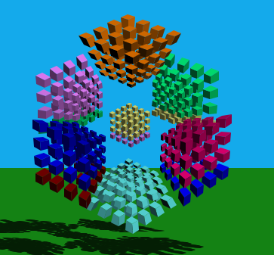
Extending The Learning

Slide 47
A Geomagic Square based on Luo Shu. There are solutions to the rows on the right.
Can you solve the columns or diagonals?
Notes:
Lee Sallows Geomagic Square based on Luo Shu made of polyominoes ranging from 1 to 9 with three solutions on the right hand side (each with a unit missing). Pupils may notice that the smaller turquoise units correspond to the three largest minuses in slide 6.

Slide 48
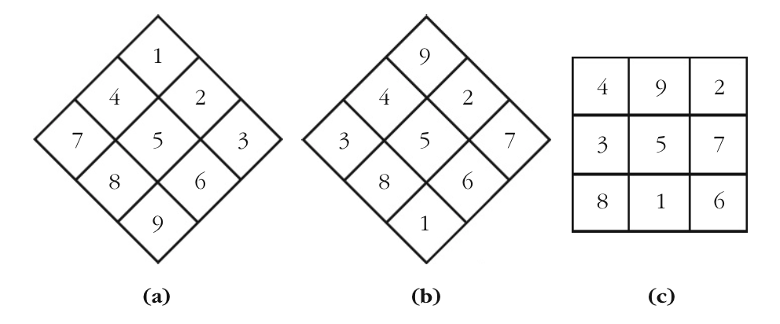
A quick way of creating the Luo Shu Magic Square
Notes:
Extension activty. This method can be applied to create larger odd numbered Magic Squares.

Slide 49
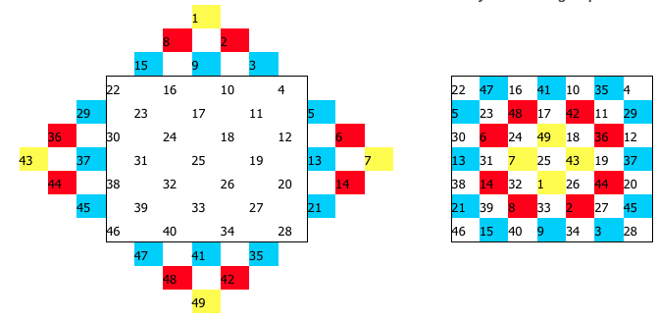
Here is how to use this method to make a larger odd numbered Magic Square
Notes:
https://www.magischvierkant.com/two-dimensional-eng/7x7/diagonal-method/

Slide 50
The Formula for the Magic Number (Magic Constant) of a Magic Square
Where:
M = the Magic Constant
n = the order of the Magic Square (number of rows or columns)
n² = the total number of cells (and numbers) in the Magic Square
M = n(n² + 1)/2
Example: Luo Shu Magic Square:
M = 3(9 + 1) = 10/2 = 5

